Slide 1
CRIME ANALYSIS ON SRICITY

Slide 2
introduction
To analyze crime patterns in Sri City using GIS technology
Aims to identify hotspots, trends, and patterns of crime in Sri City
Creation of maps and visualization of the data to help identify spatial patterns and trends
More police stations hospitals on high alert places

Slide 3
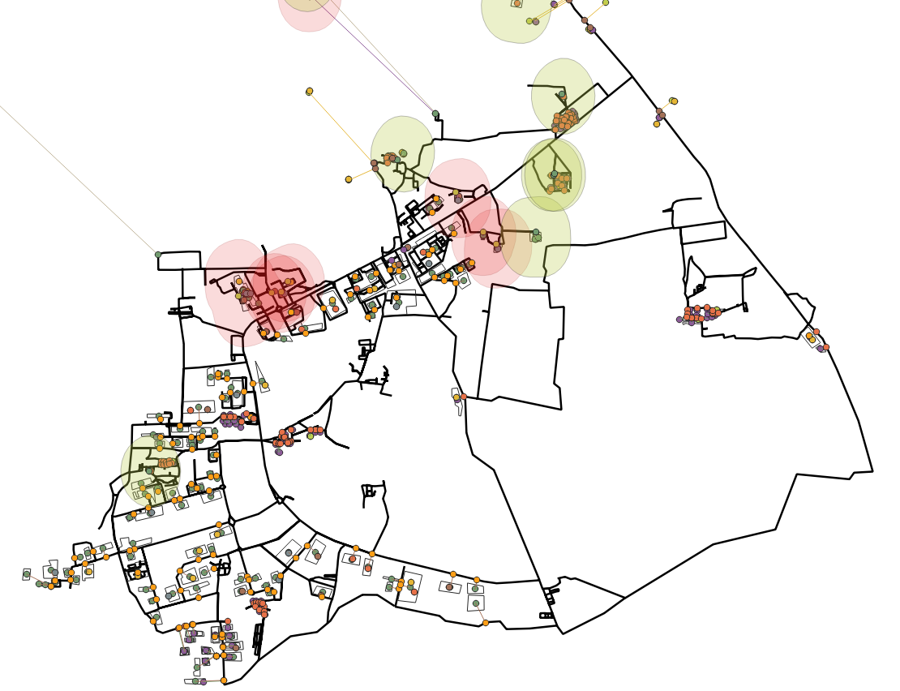
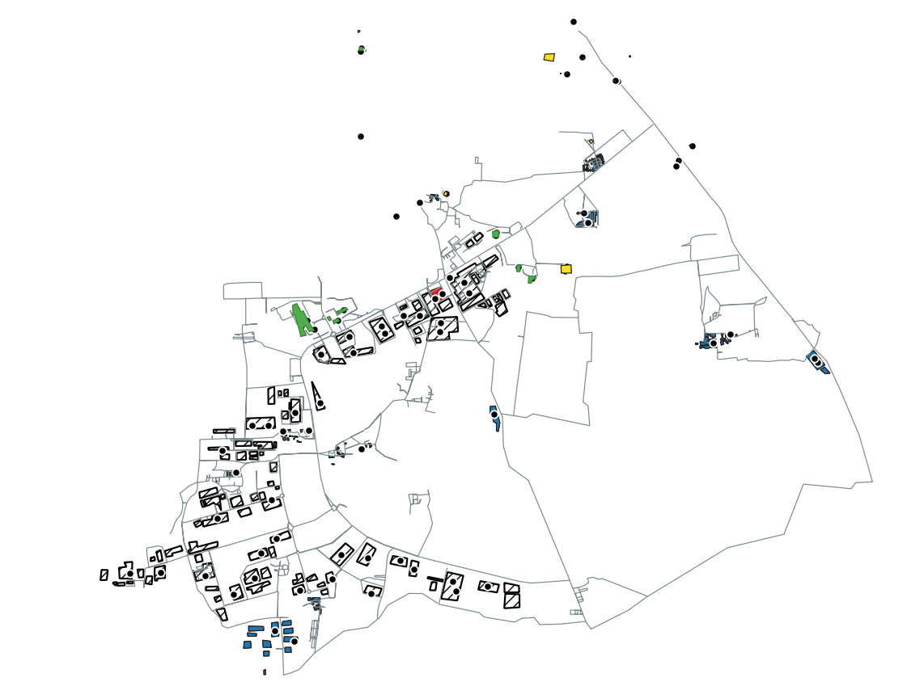
objectives
To create a model which will helpful to find shortest distance from place to place, and which area is preferable such that crimes are less, and finding places which has more crimes, and etc

Slide 4
Raster layers:
Vector layers:
Base map
Heat map representing crime density across the area.
Road layer
Temple layer
School and university layer
Hospital layer
Crime data point layer
Houses
Police stations
industries

Slide 5
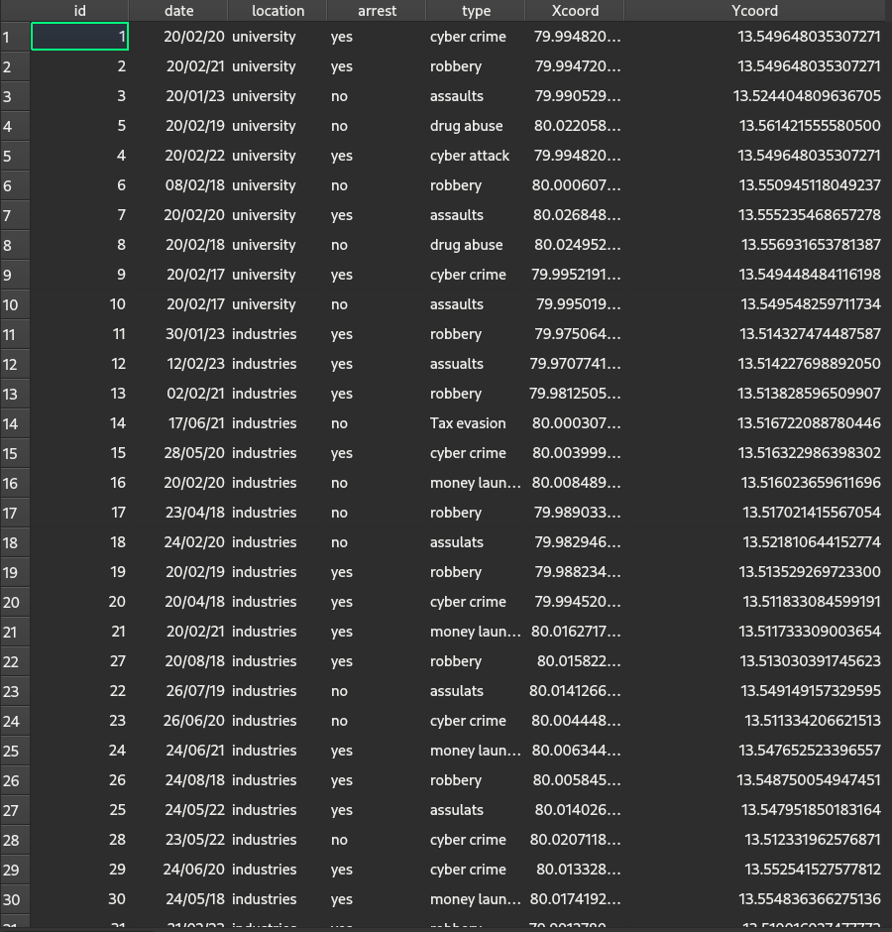
Crime Dataset
Id (inbuilt)
Date (date of crime)
Location (like which layer crime has happened (University, Industries, temples, schools, police stations, houses)
Arrest (yes or no)
Type (drug use, robbery, money laundry, assaults, etc)
X,Y coordinates

Slide 6
Methodology:
Discretizing the layers from google earth
Creating dummy dataset.
Using gis software for analysing the data
Identify areas with high crime density, including hotspots, trends, and patterns.
Interpret the results and draw conclusions about the crime situation in the Sri City area.

Slide 7
Basic Analysis:
Crime should not happen near schools and universities.
The places where crime is likely to happen are hotspots.
Police stations should be located near high alert areas.
Hospitals should be located close to high alert areas.
Houses should not be located in high alert areas.
Roads must be connected to high crime areas and the nearest hospitals for better transportation of victims.
School zones must be protected at all costs, which includes a 1km radius from schools.

Slide 8
Further analysis
Calculating the distance between the nearest hospitals.
Evacuating houses located in high crime areas.
Creating contours or clusters as a raster form for visualizing high and low crime areas.
Finding the shortest distance between the crime spot and hospitals for traveling in case of an emergency.
Finding fastest route on road to get to hospital
Shortest path and fastest paths
Analysing crimes on school buffers

Slide 9
Results so far
Interpolated road as discrete point layer for better analysis
Dividing crime data to sub layers based on their crime type
Calculating centroids of polygon layers (houses ,industries etc)
Finding shortest path from centroid to road layer
Keeping track of closest point of shortest path(location of point)
Buffering the school and universities
Finding intersection of buffer zones and crime data so on

Slide 10
A QUICK DEMO

